Slide 1

What’s Happening In Myanmar
Denver University Data Project 2.
Justynn H.
Lisa C.
Renuka K.
Joey R.

Slide 2
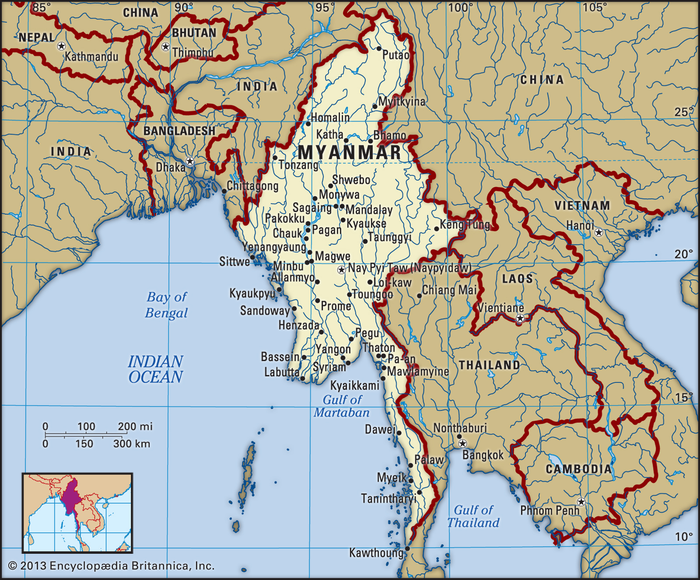
Where is Myanmar?
Notes:
Myanmar, also known as Burma, is in South East Asia. It neighbours Thailand, Laos, Bangladesh, China and India.
Myanmar has a population of about 54 million.
The main religion is Buddhism. However, there are many ethnic groups in the country, including Rohingya Muslims.
Many of you may have never heard of Myanmar bcuz The ruling military changed the country's name from Burma to Myanmar in 1989. The two words mean the same thing but Myanmar is the more formal version.
But without telling you too much I will let the expert in our group, Lisa, explain the conflicts going on at the moment there.

Slide 3
#WhatishappeninginMyanmar?
Background | Recent coup | SCOPE OF THIS PROJECT
The Burmese military first overthrew the civilian government in 1962, shutting the country off from the outside world. | The NLD won 75% of the vote in recent elections in Nov 2020. The military’s political party won very few votes. | Attempt to quantify and analyze the scope of violence enacted by the military and police. | The Armed Conflict Location and Event Data Project (acleddata.com) API was used to generate data. Plotly and heatmaps used for analysis.
Uprisings in 1988 and 2008 were met with brutal force, with the military and police murdering thousands. | The military overthrew the government on Feb 1, 2021. Peaceful protests began the next day and have continued ever since. | Consolidate social media mentions and uses of hashtags. This is where most of the current info is found. | Twitterbot used to scrape Twitter for commonly used hashtags.
The country held its first democratic elections in 60 years in 2015, sweeping Aung San Suu Kyi’s NLD party to power. | What’s different? Widespread internet access and social media. | Give a human face to the numbers and capture the extent of the brutality. | CSV file with links to images to populate map, Photo Bucket to display images and submission form to track abuses.

Slide 4
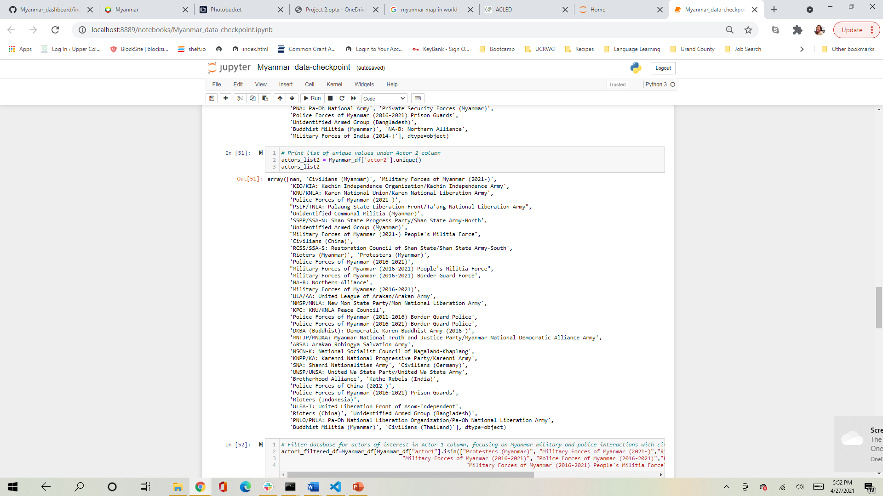

Lisa C.
Data from ACLED API needed to be cleaned.
Dropped conflicts with various armed groups in border areas to focus on military response to peaceful protests of coup.
Difficult to find a way to host images from social media without a server.
Limited storage space on GitHub and Heroku.
Ended up using images from news sources, making a CSV file.
Doesn’t permit documenting more serious abuses, difficulty in giving anonymous platform.
Where should the “SUBMIT” button go?

Slide 5
Justynn H.
Twitter Bot.
Likes, Retweets, Mentions.
Follows profiles who follows our account.
Retweet any tweets with certain #Hashtags
Creates continuous updating / monitoring of our specifications.
What have I Learned?
745 civilians Killed
4410 arrested
3371 detained
1118 warrants still outstanding
Myanmar Internet shutdown still on going for the 34th day (as of 2021 April 24^{th )}

Slide 6
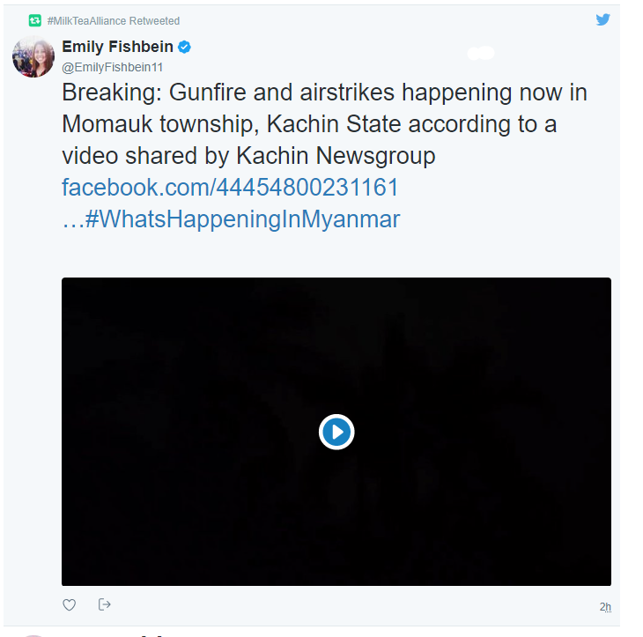
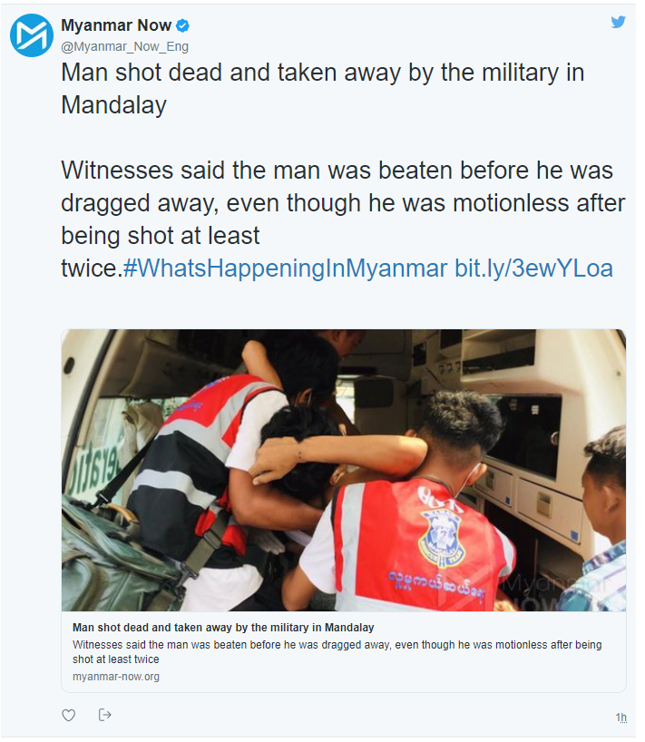
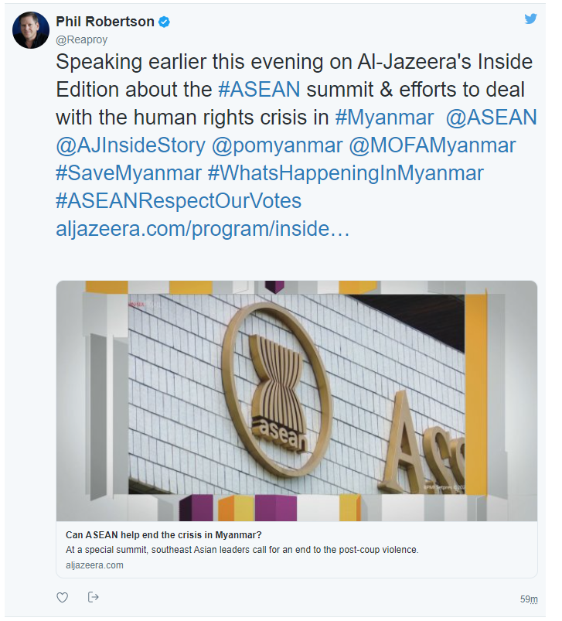
Examples of Twitter Bot Capabilities.

Slide 7
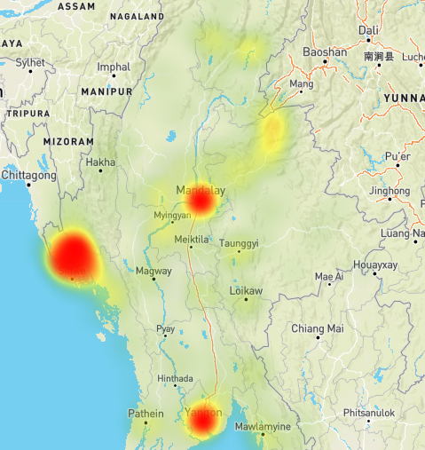
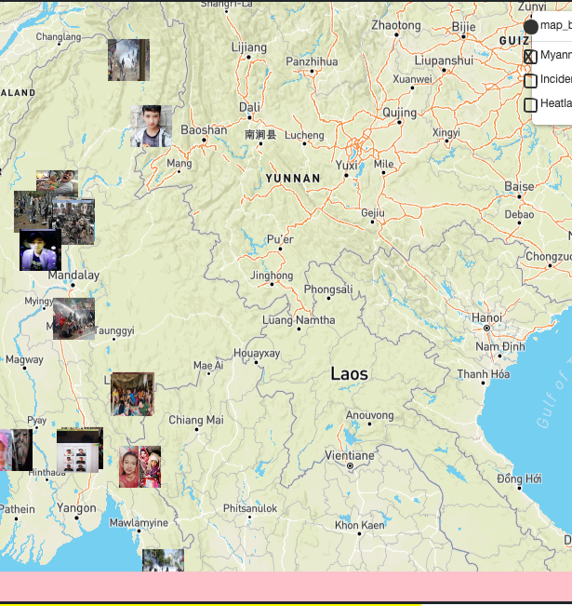
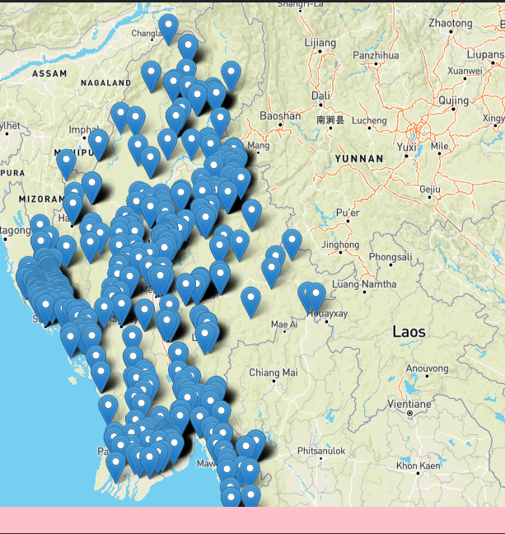
Heat & Marker/Image Map
Notes:
Through Leaflet we were able to created a heat and marker map indicating incidences throughout the country that have been recorded and documented. When you click on a marker it will tell you the place and incident type. Ranging anywhere from protest with intervention to shelling/artillery/missle attack . Lisa created the marker map linking photos to specific instances to give you a better understanding of whats going on.

Slide 8
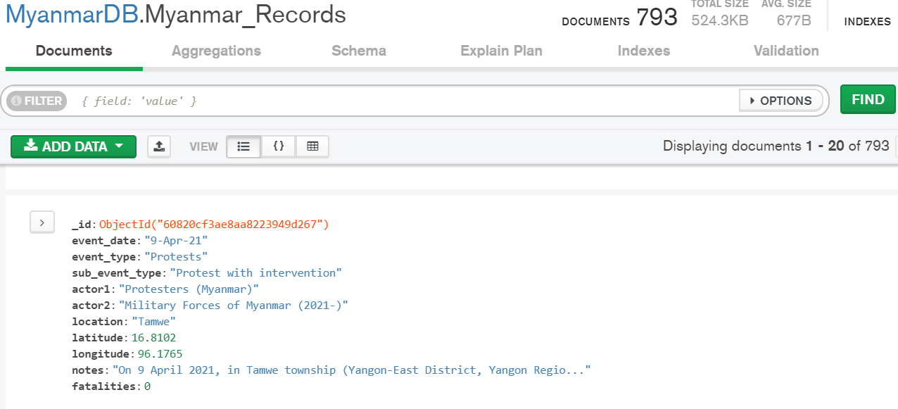
Database API
ACLED database API was used to collect Political Violence and protest data for Myanmar .
Data source used: Data Export Tool | ACLED (acleddata.com)
Dates collected: Feb 1, 2020 to most recent
Data collected as CSV file, cleaned for relevant information.
Created Database in Mongo, data Pushed to Mongo DB.
Created python Flask API to render data.

Slide 9
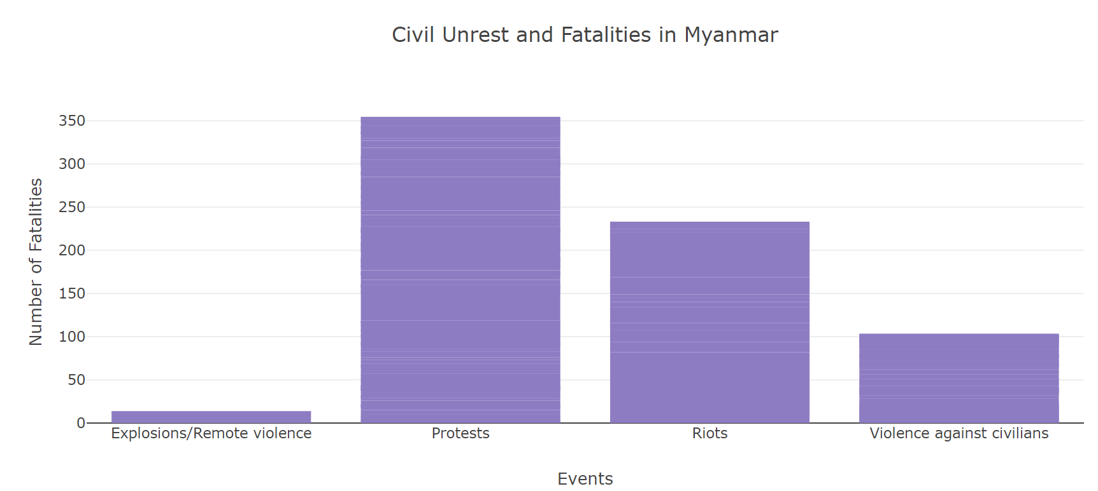
How many lives were lost since the Military coup started 2/1/2020?
The chart shows fatalities resulted from Military response to peaceful protest, riots and violence against civilians.
Data Source: Acleddata.com

